Slide 1
SEP 728 Project
IIoT Solution for a Steel and Wood Manufacturing Factory
By:
Daniel Hilal
Kunal Garg

Slide 2
Outline
Project Requirements
Factory Machines
Solution Architecture
Why MQTT with Sparkplug B
Why Ignition
Why AWS
Integration: MQTT, Sparkplug B, Ignition and AWS
Implementation
Simulating PLC and HMI
Simulating IoT Sensors
Simulating OPC UA Server
Publishing Data to Broker
Developing SCADA Project
Mobile Application SCADA
Alarm Notifications
References

Slide 3
Project Requirements
Overview: Architecting an IIoT solution, tailored for steel and wood manufacturing machines, to improve and have a better understanding of their performance and safety.
Collecting data from the control system of steel and wood manufacturing machines
Collecting data from external sensors
Using the data collected to display useful information and issue alerts and control commands to the plant floor

Slide 4
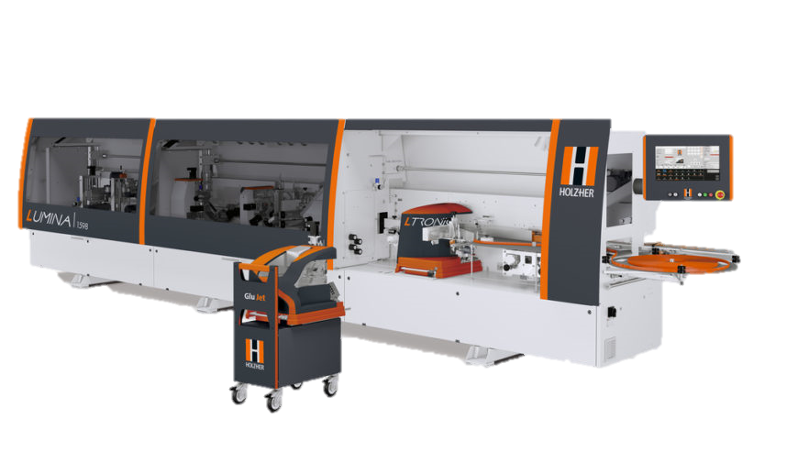
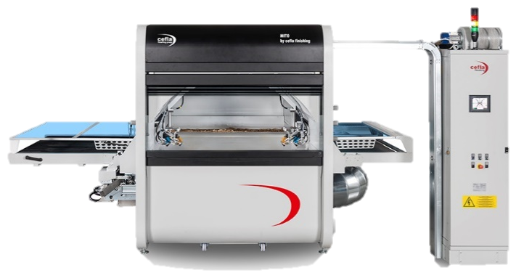
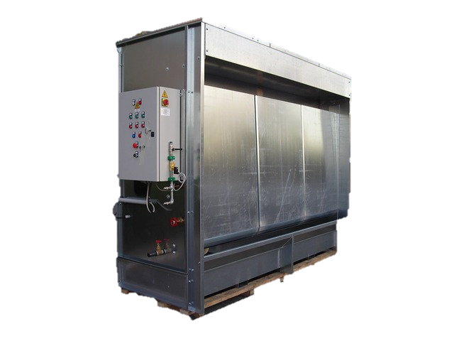
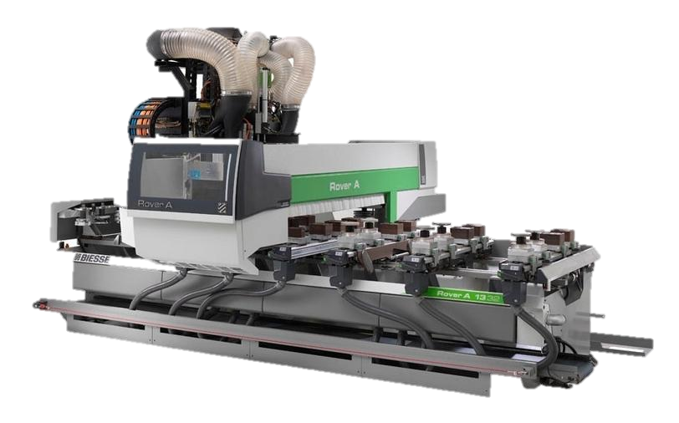
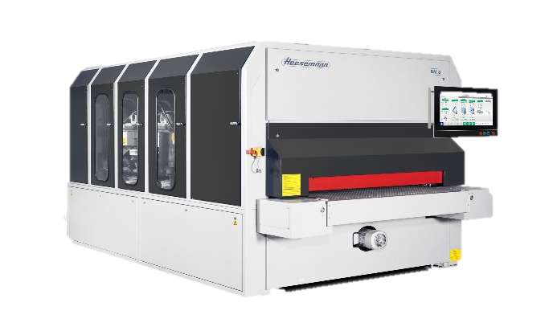
Factory Machines
Automated Painting Booth - CEFLA MITO
Edge Bending Machine - HOLZHER LUMINA 1586
CNC Router - BIESSE ROVER A 1332 ATS
Sanding Machine - HEESSEMAN BM8
VEIL PAINTING BOOTH

Slide 5
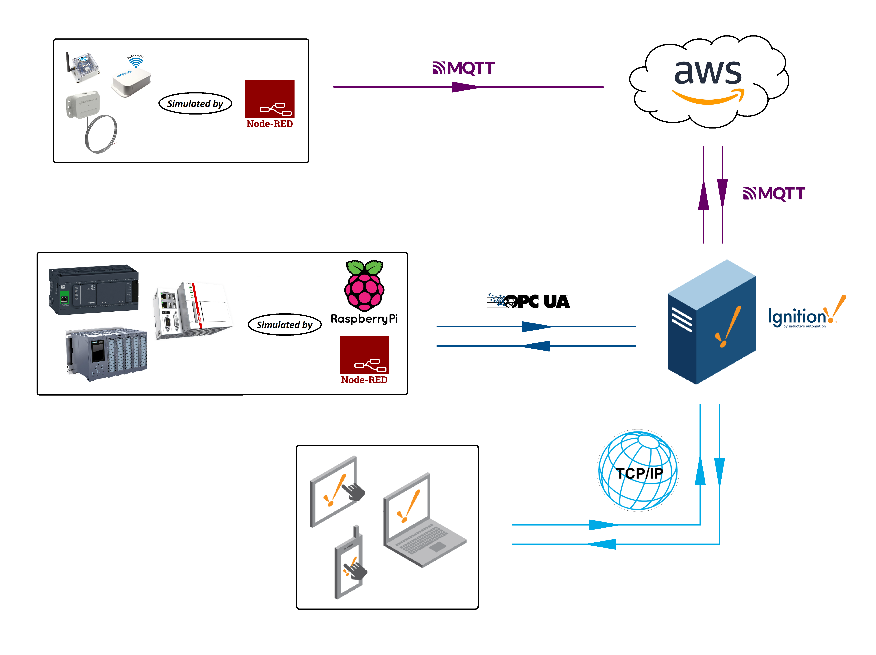
Solution Architecture

Slide 6
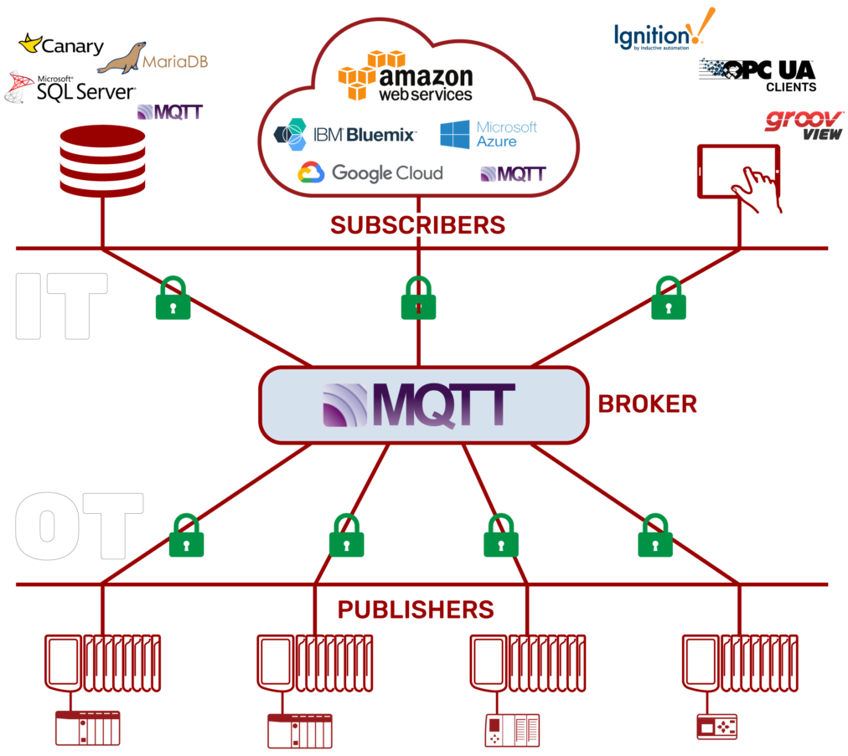
Why MQTT with Sparkplug B
MQTT (Message Queue Telemetry Transport) is a lightweight message protocol that is based on a subscription-publishing model.
Sparkplug B formats the MQTT message to be easily managed and discovered.
Designed for industrial applications:
Extremely lightweight
Energy efficient
Secure
Data-agnostic
Easily implemented
Notes:
Clients do not have addresses like in email systems, and messages are not sent to clients.
Messages are published to a broker on a topic.
The job of an MQTT broker is to filter messages based on topic, and then distribute them to subscribers.

Slide 7
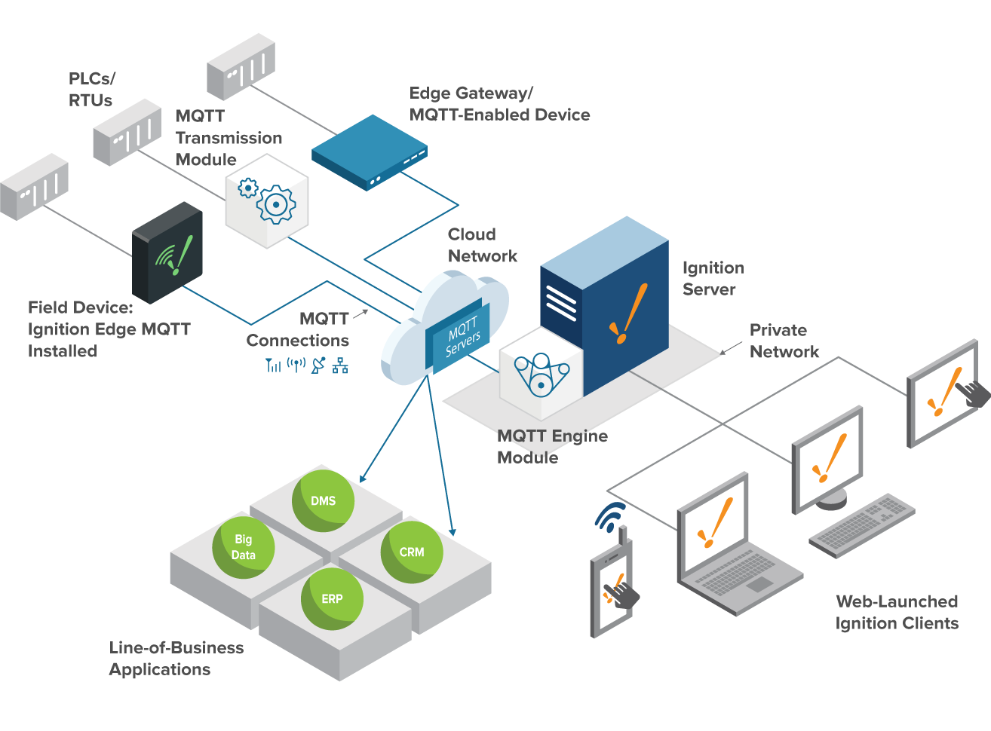
Why Ignition
Server Based
Cross Platform
Simple Licensing
Notes:
Server Based: One computer controls everything
Simple Licensing: One license for the server gives you unlimited access, such as unlimited Clients, unlimited Tags, and unlimited projects.
Cross Platform: Ignition works with any major operating system, even iOS and Android.

Slide 8
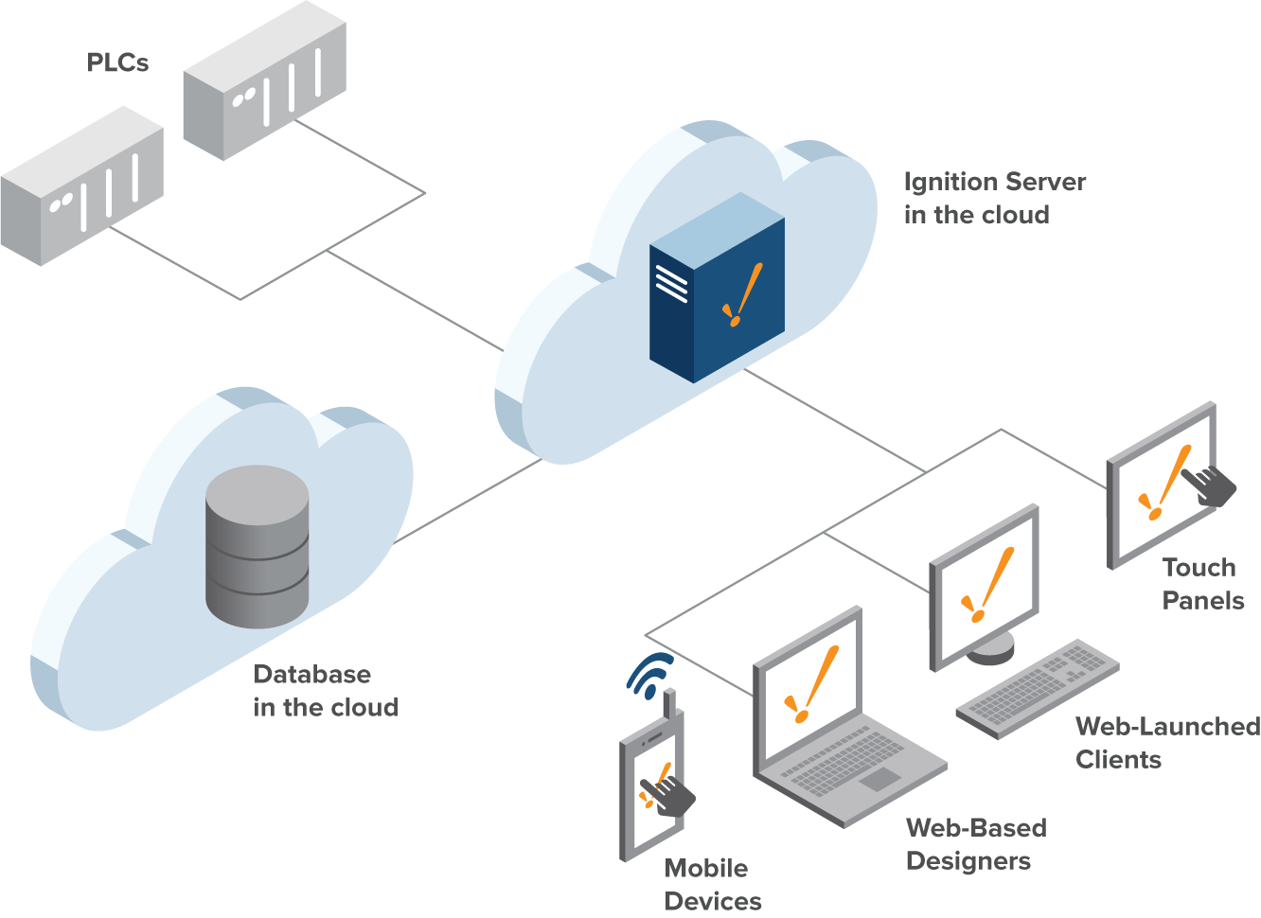
Why Ignition
Web-based Deployment
Web-launched Designer and Client
Notes:
Web-based Deployment: Ignition is installed, deployed, and managed using standard web technologies.
Web-launched Designer and Client: Ignition's Designer tool and runtime clients and sessions are launched using the web.

Slide 9
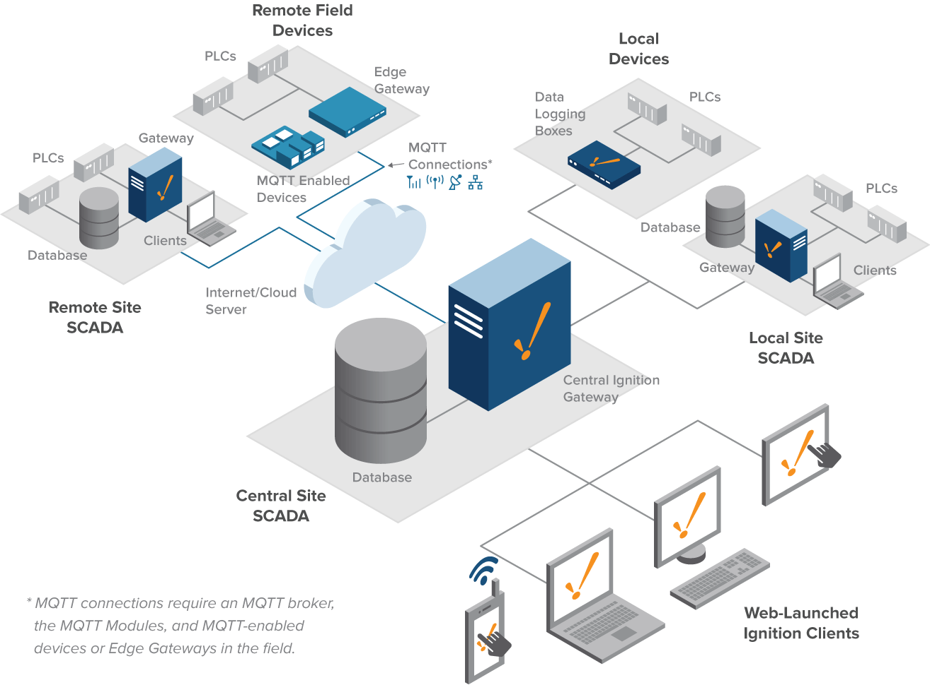
Why Ignition
Scalable Modular Architecture
Built-in Security
Notes:
Scalable Modular Architecture: Create a scalable and centrally managed SCADA system using Ignition's web-based server architecture.
Built-in Security: Security is built in to every aspect of Ignition.

Slide 10
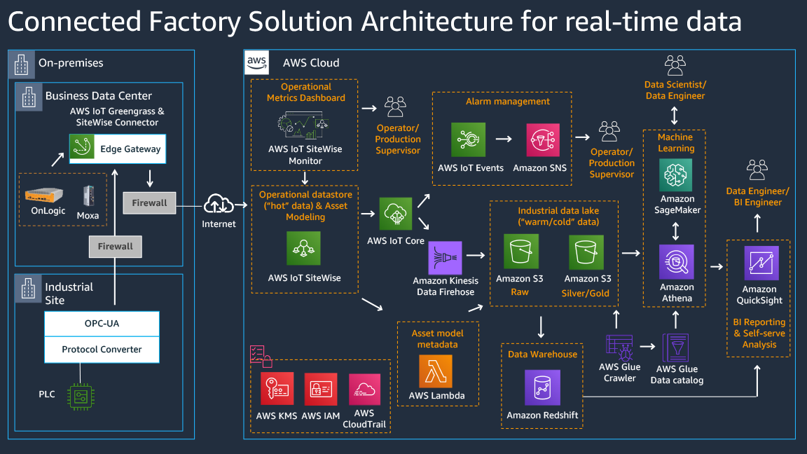
Why AWS
Notes:
Authentication: X.509 client certificate
Port: 8883

Slide 11
Why AWS
AWS broker:
AWS IoT manages device communication through a message broker.
This broker can also forward messages to the AWS IoT rules engine, which can act on the content of the message.
AWS security:
Device connections to AWS IoT use X.509 client certificates and AWS signature V4 for authentication.
Device communications are secured by TLS version 1.2
AWS IoT requires devices to send the Server Name Indication (SNI) extension when they connect.
AWS device endpoints that support specific device-centric IoT functions, services and security.
Notes:
Authentication: X.509 client certificate
Port: 8883

Slide 12
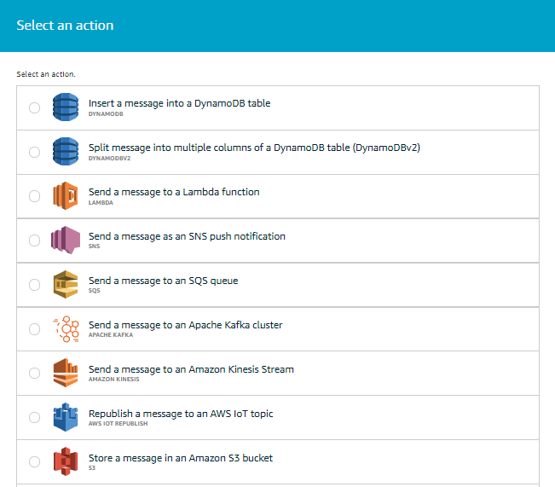
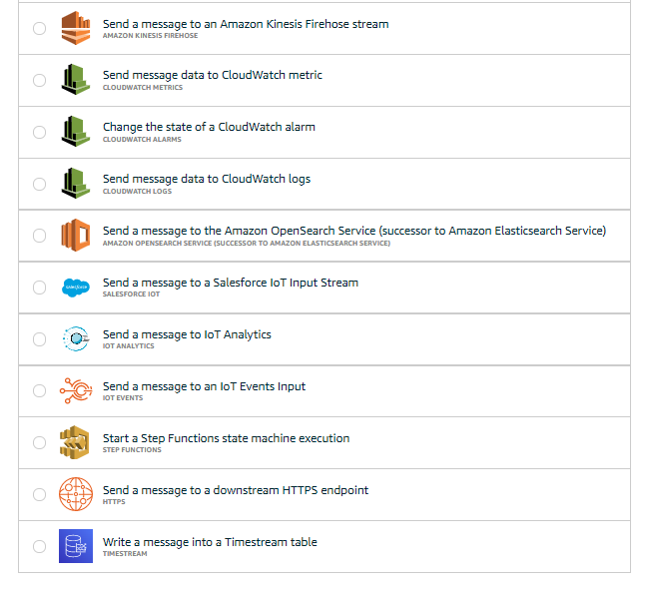
Why AWS
AWS Rules:

Slide 13
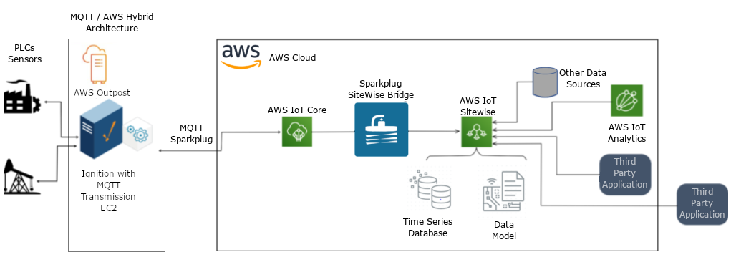
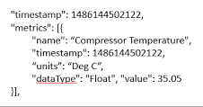
Integration: MQTT, Sparkplug B, Ignition and AWS

Slide 14
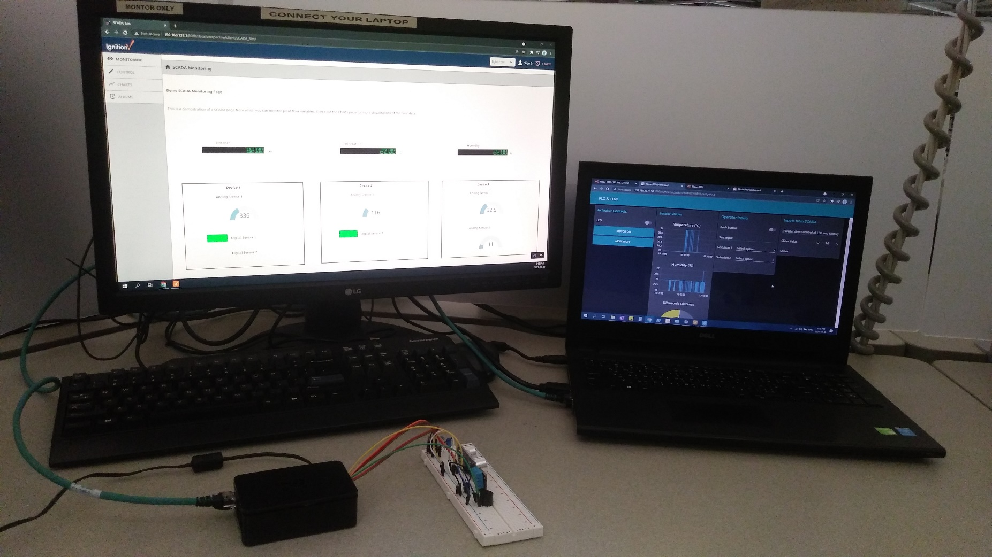
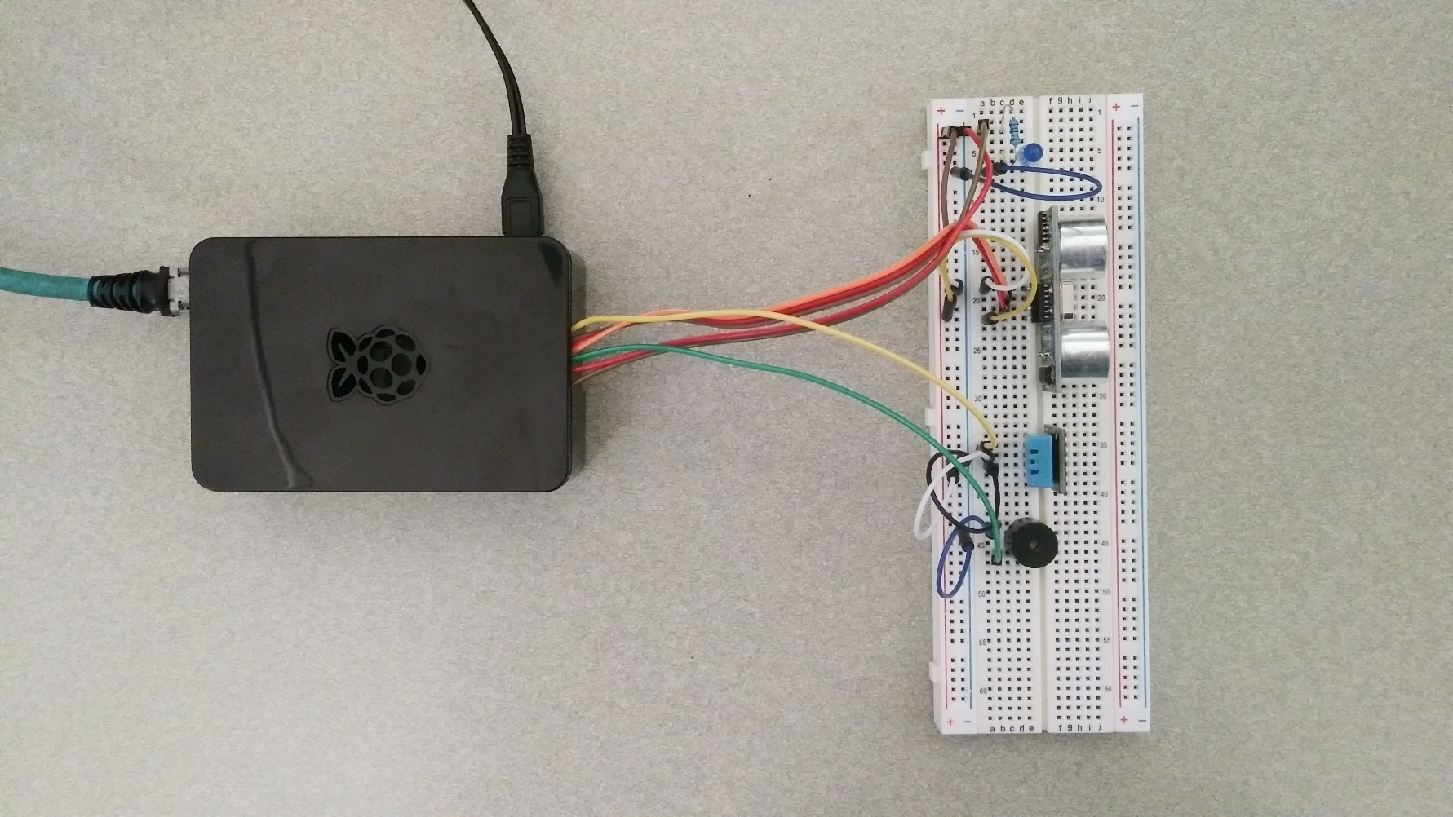
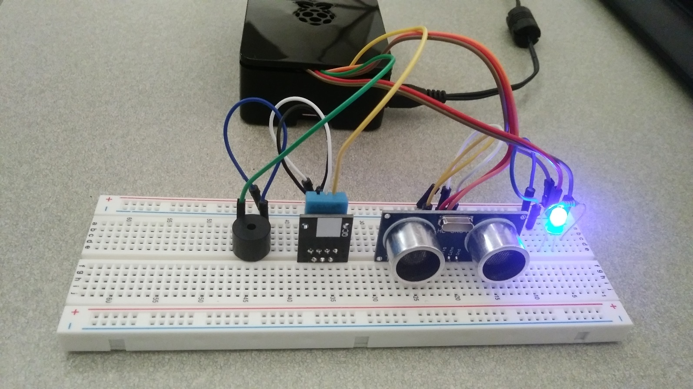
Implementation

Slide 15
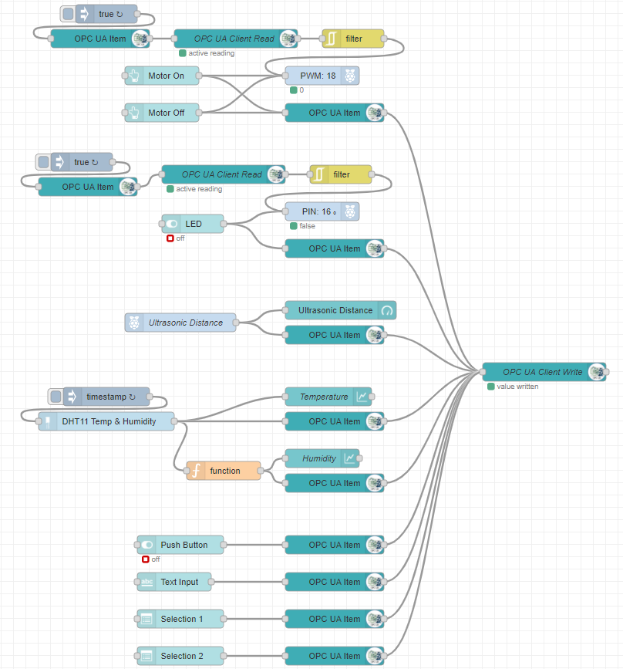
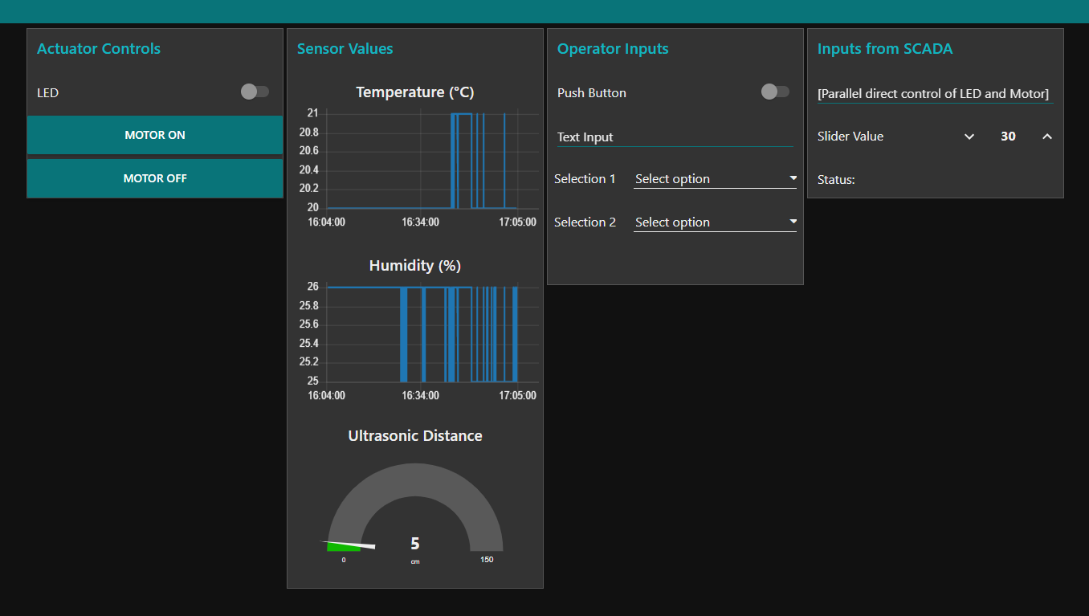
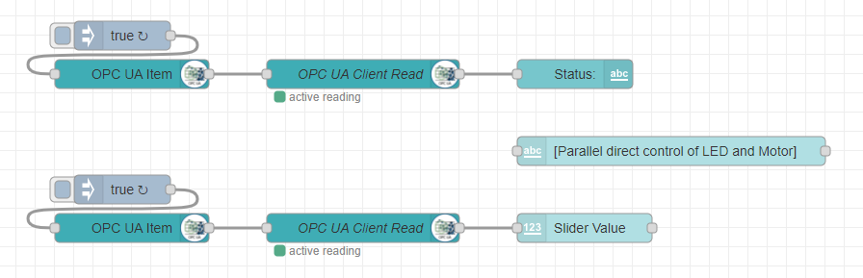
Simulating PLC and HMI

Slide 16
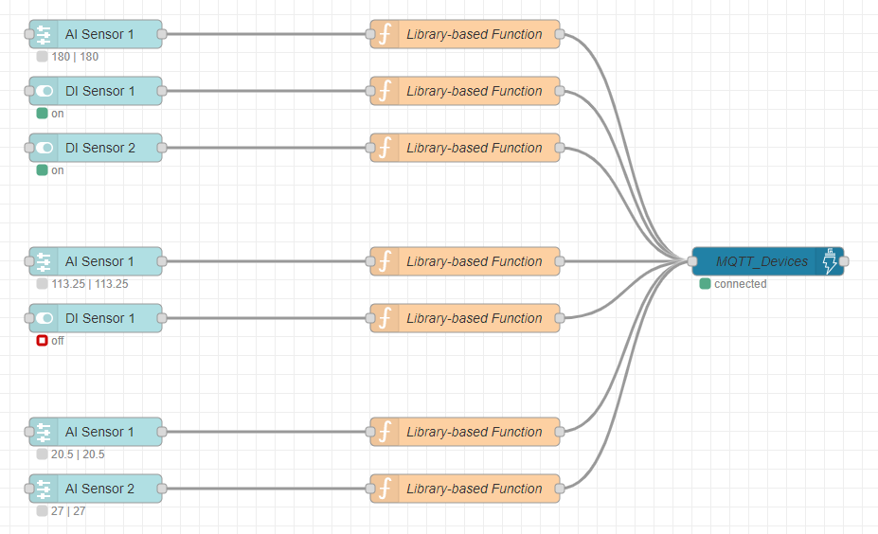
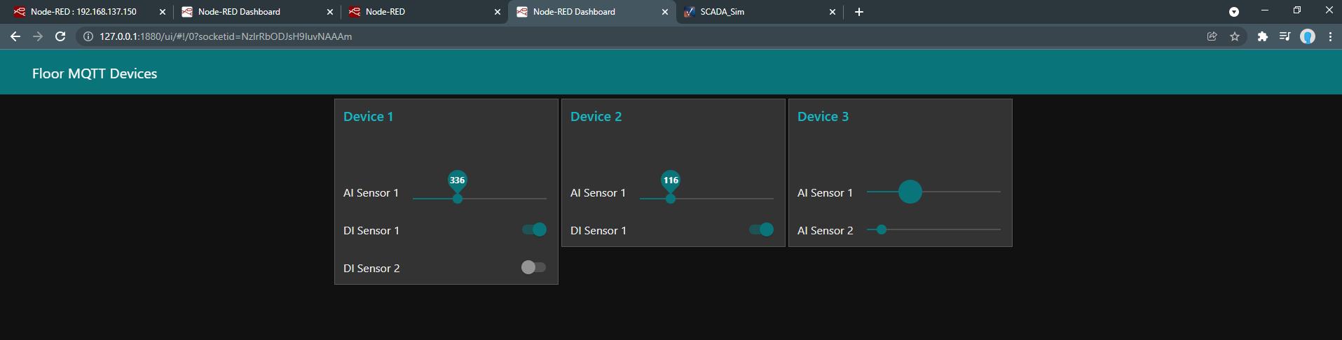
Simulating IoT Sensors

Slide 17
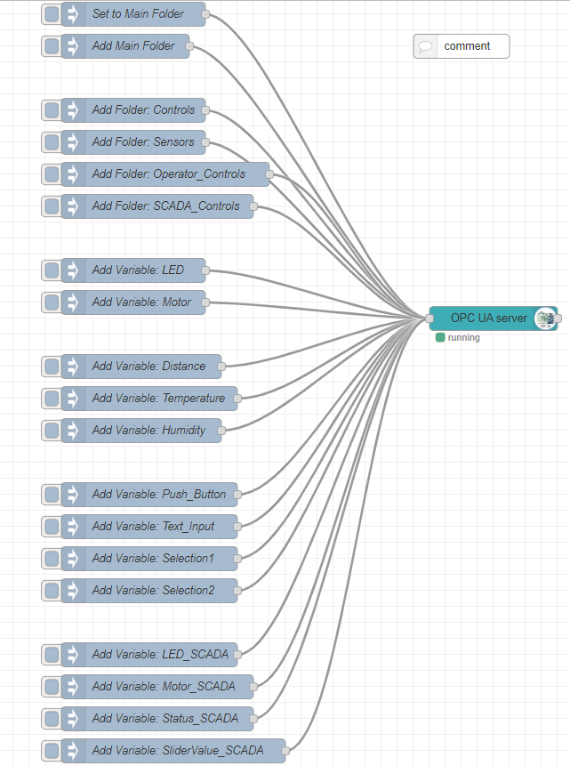
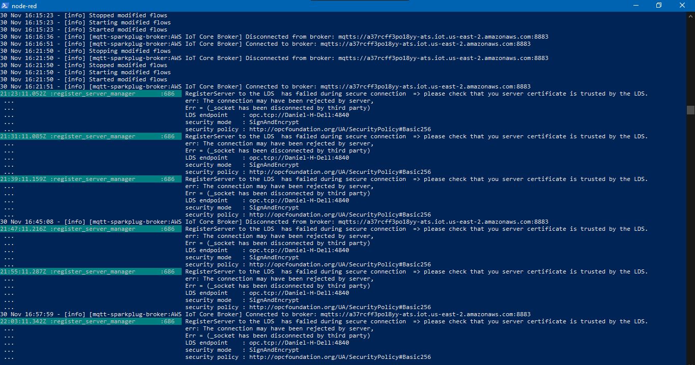
Simulating OPC UA Server

Slide 18
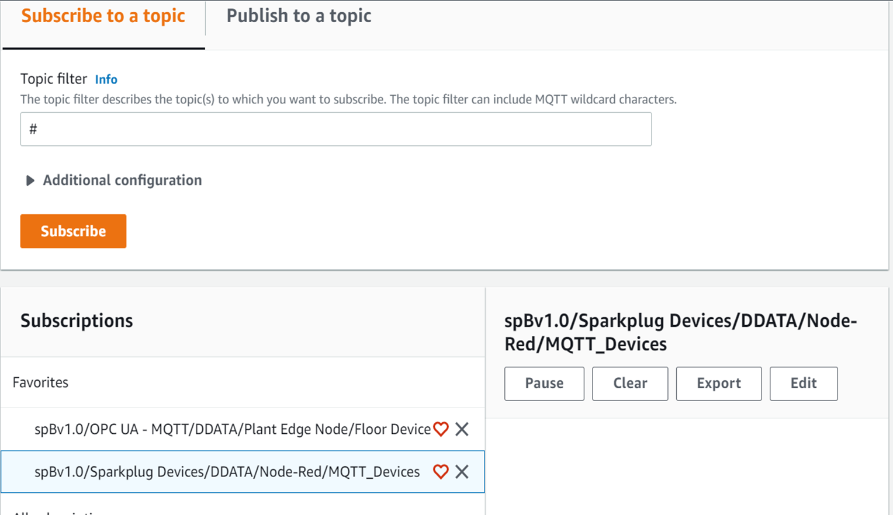
Publishing Data to Broker

Slide 19
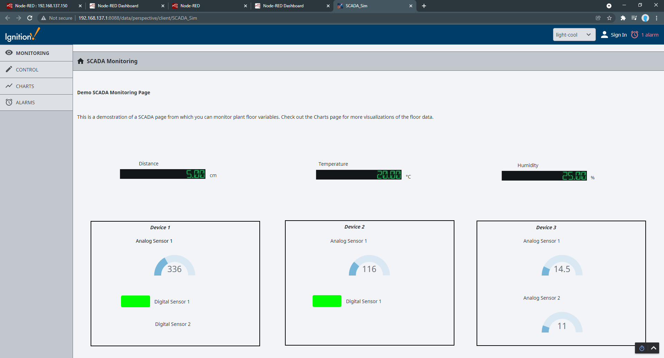
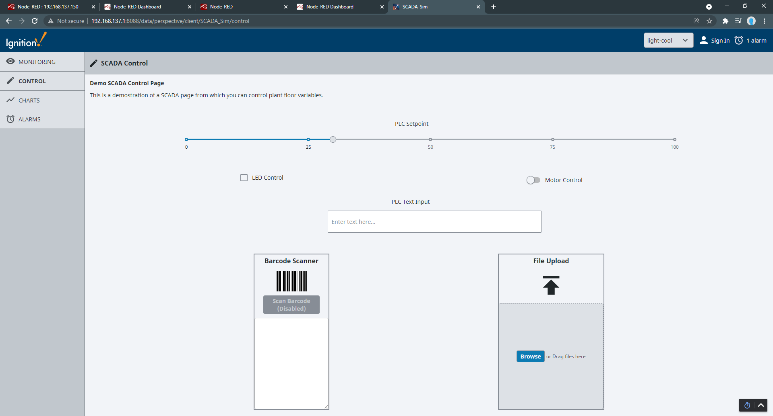
Creating SCADA Project

Slide 20
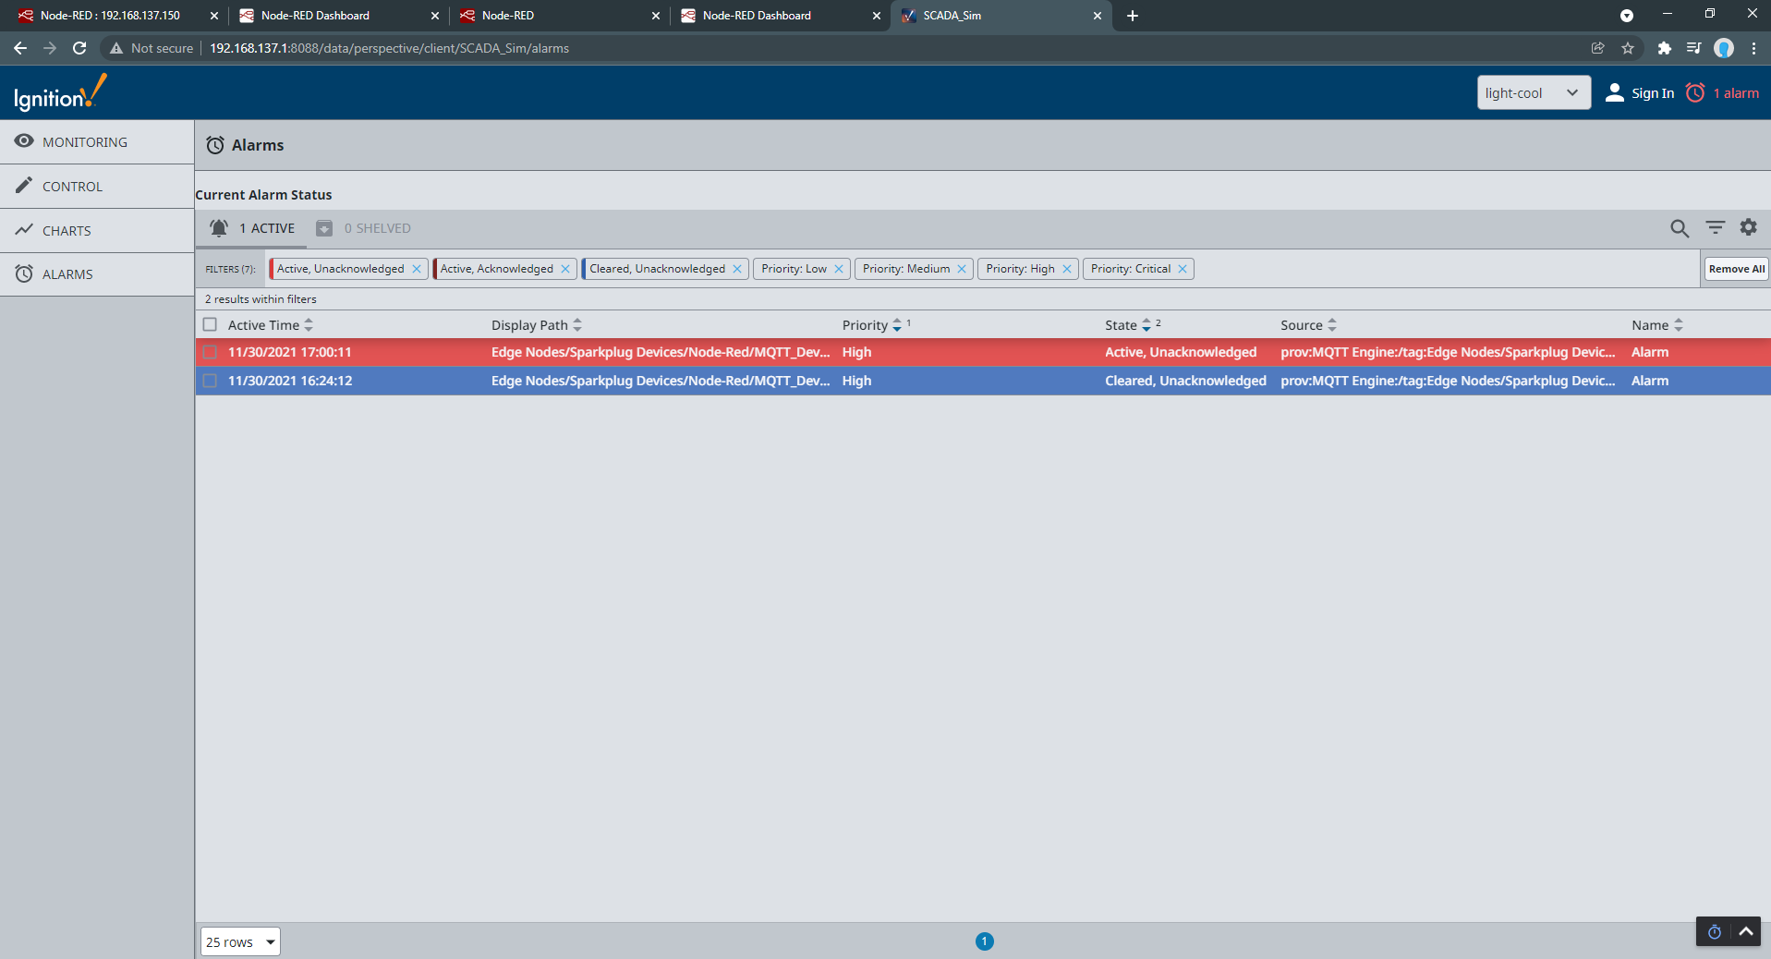
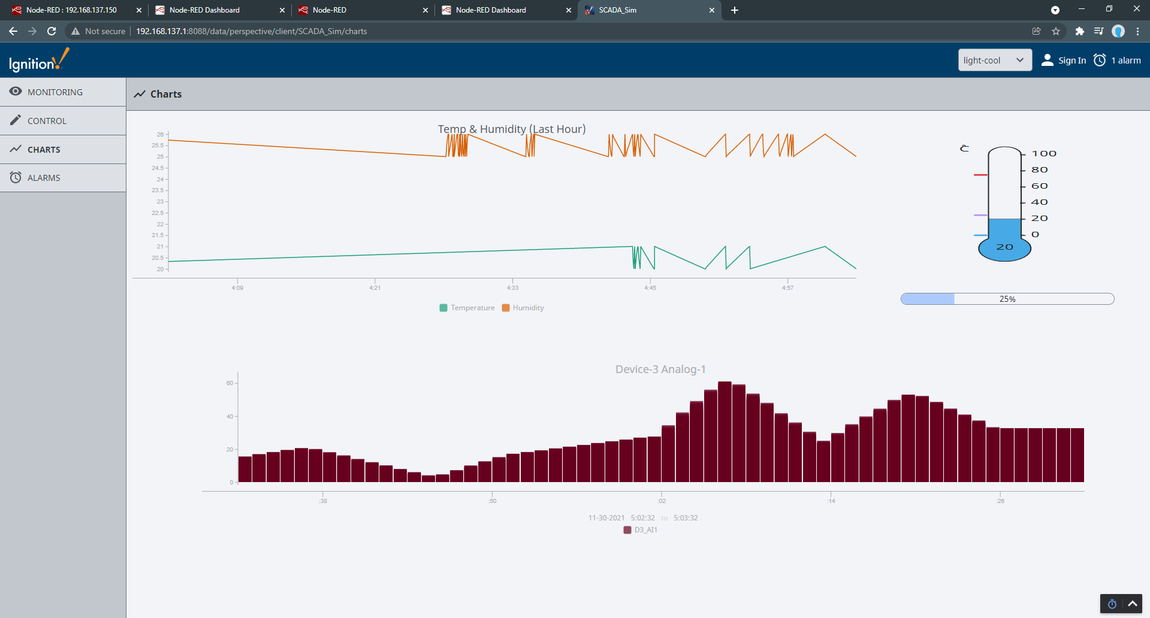
Developing SCADA Project

Slide 21
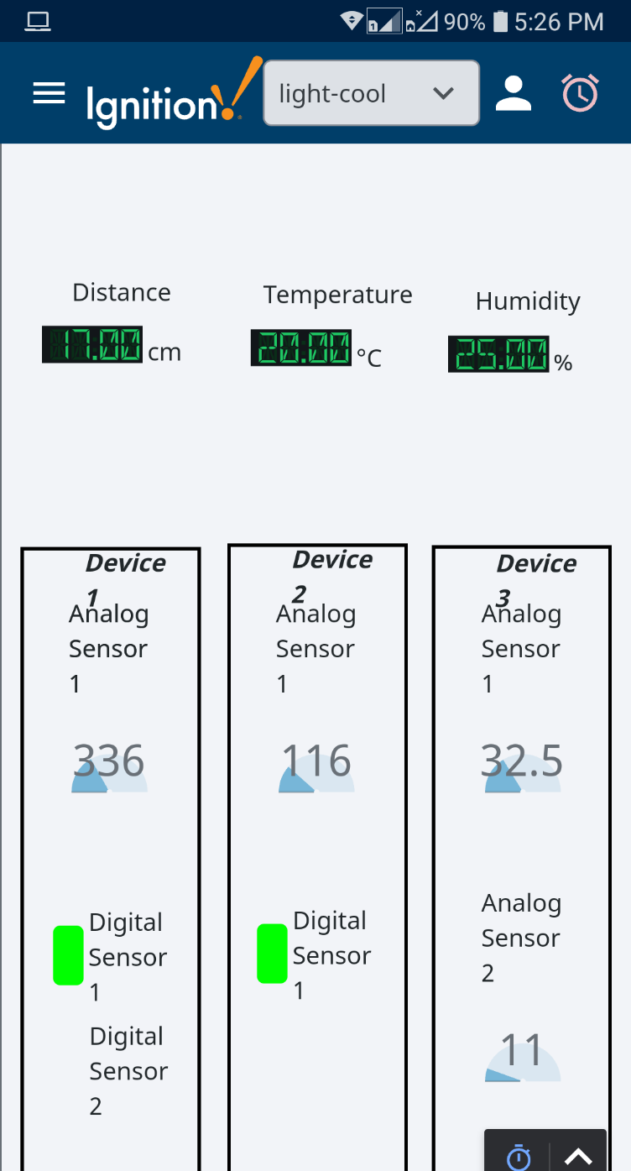
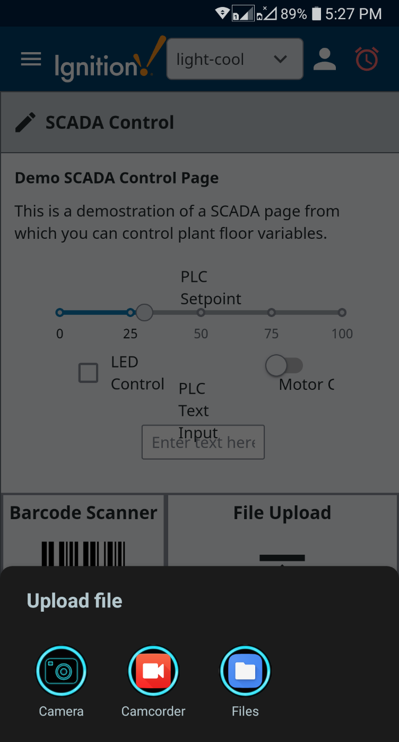
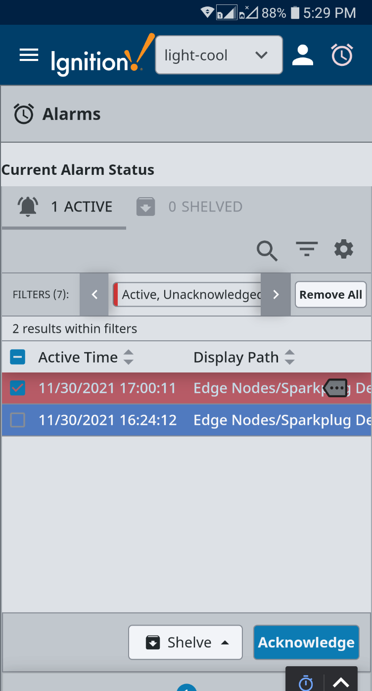
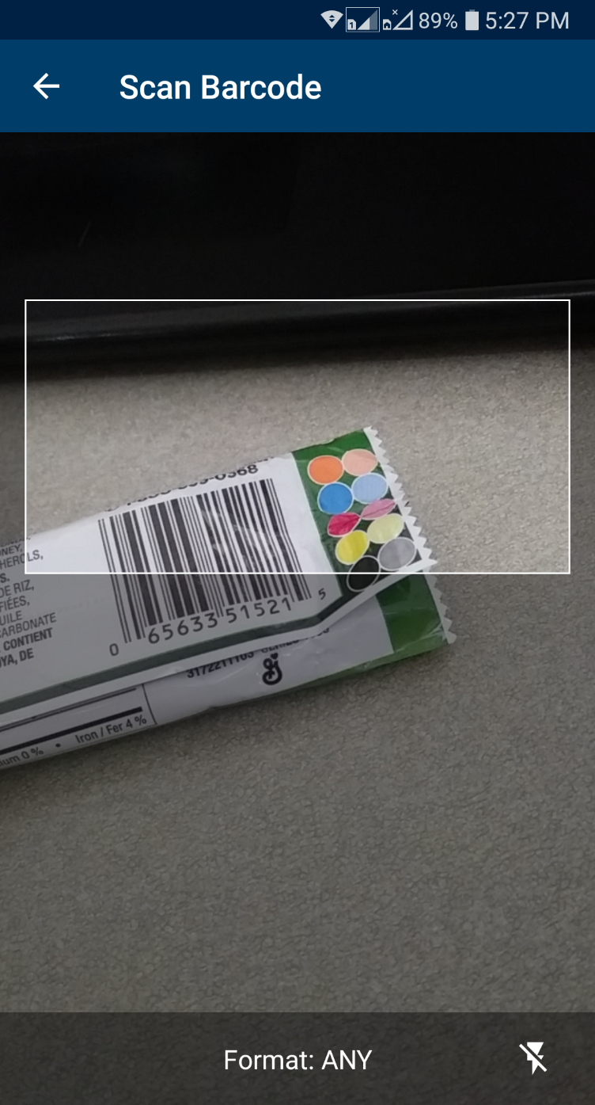
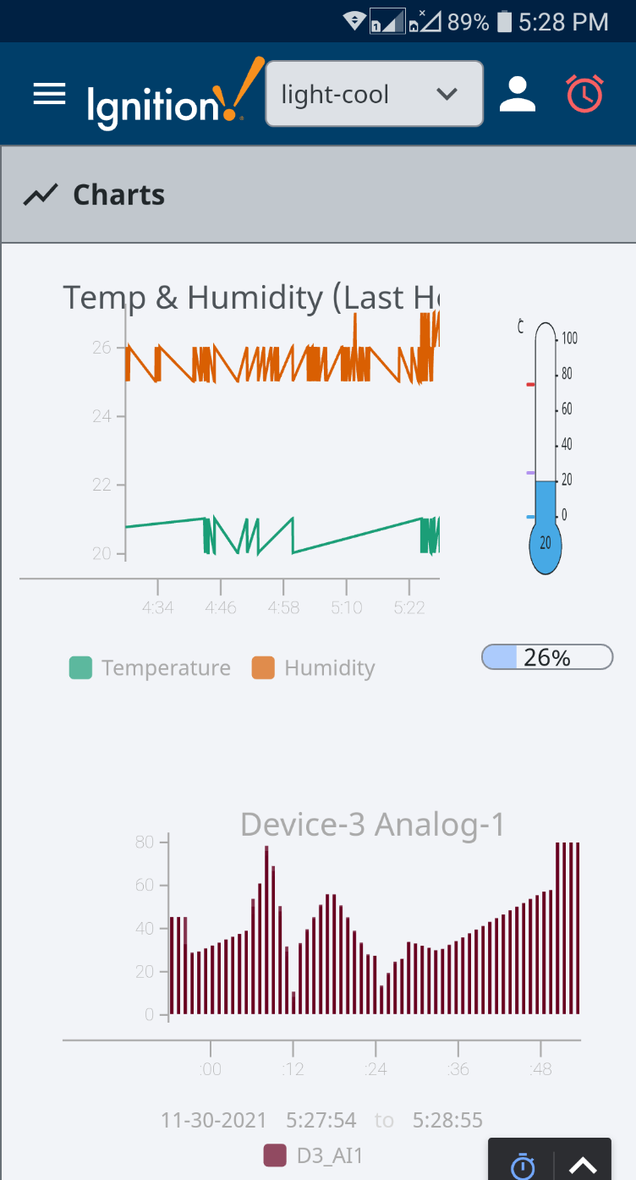
Mobile Application SCADA

Slide 22
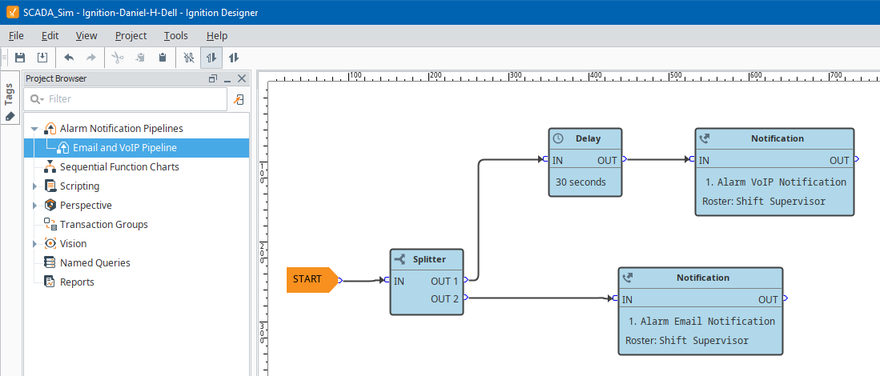
Alarm Notifications

Slide 23
References
AWS, “AWS IOT SiteWise Documentation,” Amazon Documentation. [Online]. Available: https://docs.aws.amazon.com/iot-sitewise/. [Accessed: 01-Dec-2021].
AWS, “AWS IOT Core Documentation,” Amazon Documentation, 2017. [Online]. Available: https://docs.aws.amazon.com/iot/index.html. [Accessed: 01-Dec-2021].
Cirrus Link, “SCADA system - AWS Cloud,” Cirrus Link Solutions, 12-Oct-2021. [Online]. Available: https://cirrus-link.com/aws-cloud/. [Accessed: 01-Dec-2021].
Cirrus Link, “SCADA system - MQTT software for IIOT,” Cirrus Link Solutions, 08-Apr-2021. [Online]. Available: https://cirrus-link.com/mqtt-software-for-iiot-scada/. [Accessed: 01-Dec-2021].
Eclipse Foundation, “Sparkplug™ Specification.” [Online]. Available: https://www.eclipse.org/tahu/spec/Sparkplug%20Topic%20Namespace%20and%20State%20ManagementV2.2-with%20appendix%20B%20format%20-%20Eclipse.pdf. [Accessed: 01-Dec-2021].
Inductive Automation, “Ignition Platform - Ignition User Manual 8.1,” Ignition Documentation. [Online]. Available: https://docs.inductiveautomation.com/display/DOC81/Ignition+Platform. [Accessed: 01-Dec-2021].
Inductive Automation, “Ignition Modules - Ignition User Manual 8.1,” Ignition Documentation. [Online]. Available: https://docs.inductiveautomation.com/display/DOC81/Ignition+Modules. [Accessed: 01-Dec-2021].
Node-RED, “User Guide,” Node-RED Documentation. [Online]. Available: https://nodered.org/docs/user-guide/. [Accessed: 01-Dec-2021].
OASIS Open, “MQTT 3.1.1 Specification,” MQTT Version 3.1 - Oasis, 29-Oct-2014. [Online]. Available: https://docs.oasis-open.org/mqtt/mqtt/v3.1.1/os/mqtt-v3.1.1-os.pdf. [Accessed: 01-Dec-2021].

Slide 24

Thank you!

